Slide 1
Singapura Air
A Linux project of Joeven Valenzuela

Slide 2
Introduction
Singapura Air is a global company providing the highest quality in terms of air transportation. Founded in 2012, Singapura Air flies one of the youngest aircraft fleets in the world to destinations spanning a network spread over six continents. Today, we internationally recognized as the world's leading airline and operate a modern passenger fleet of more than 20 aircraft.

Slide 3
Achievements
Best Airlines in South East Asia 2012
Airline of the Year 2012 (2nd Consecutive Years)
Most Trusted Airline 2011

Slide 4
Departments and Staffs
IT Department
Joeven Valenzuela | Manager
Maimai Mansanades | Supervisor
Angel Locsin, Christine Reyes | Team Members
Human Resource Department
Jason Albores | Manager
Isaiah San Jose | Supervisor
Danica Torres, Cyril Locsin | Team Members
Marketing Department
Ron Derek De Ramos | Manager
Perigrine Rivera | Supervisor
Solenn Huesaff, Isabelle Daza | Team Members

Slide 5
Departments and Staffs
Accounting Department
Kenneth Manansala | Manager
Kalvin James Manansala | Supervisor
Gerryl Sierra, John Michael Mendez | Team Members
Customer Service Department
Joey Reyes | Manager
Chelai Manansala | Supervisor
Camille Rivera, Sarah Valenzuela | Team Members
Pilots, Flight Attendants and Crews
Capt. Juan Dela Cruz | Capt. Jomar Titong
Capt. Zy Palomero | Paulene So
Akira Hassan | Paloma Esmeria

Slide 6
Objectives
To provide excellent services between our shareholders and customers.
To be able to install Linux Operating System to Singapura Air company.
To be able to create users and groups using Linux.

Slide 7
System Requirements
RAM size: 4GB
Hard Drive Size: 500GB
Processor Speed:1.7GHz
Display: 1200x800

Slide 8
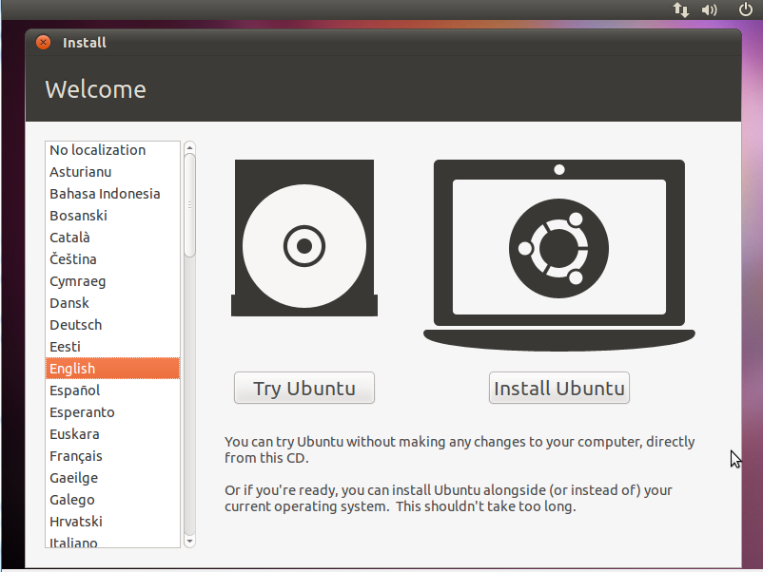
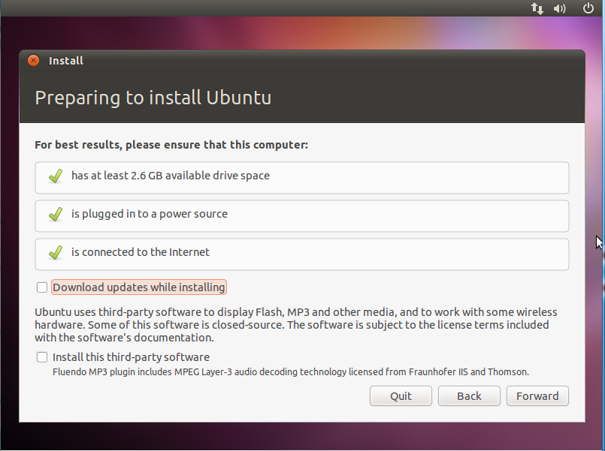
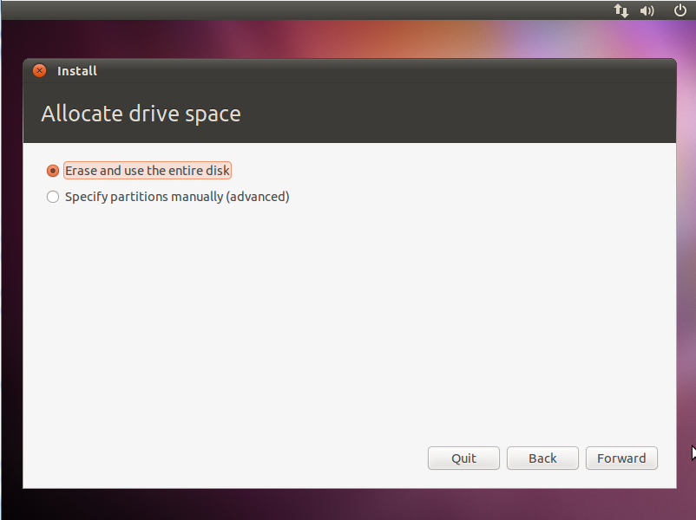
Installation

Slide 9
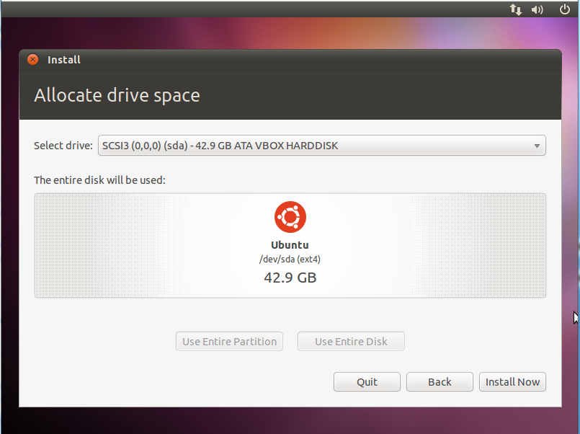
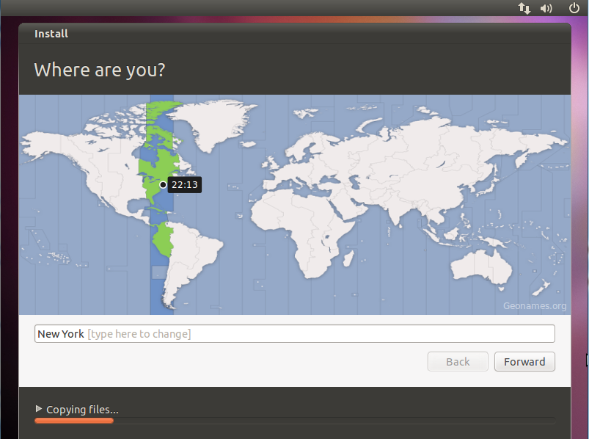
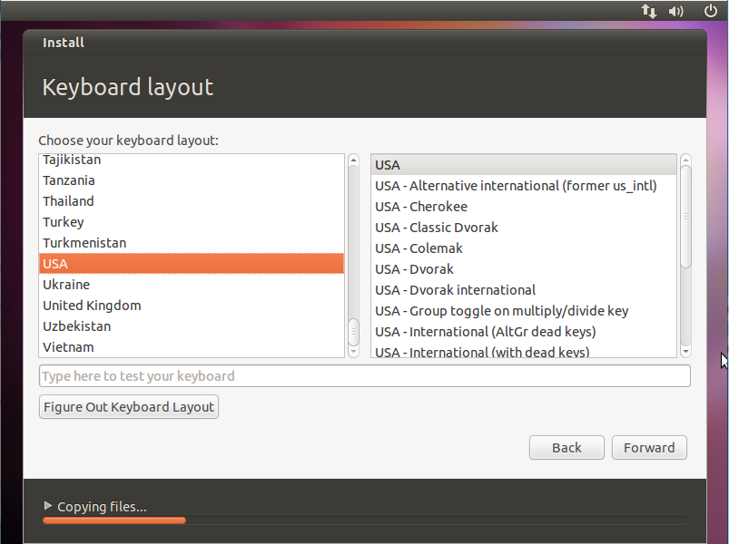
Installation

Slide 10
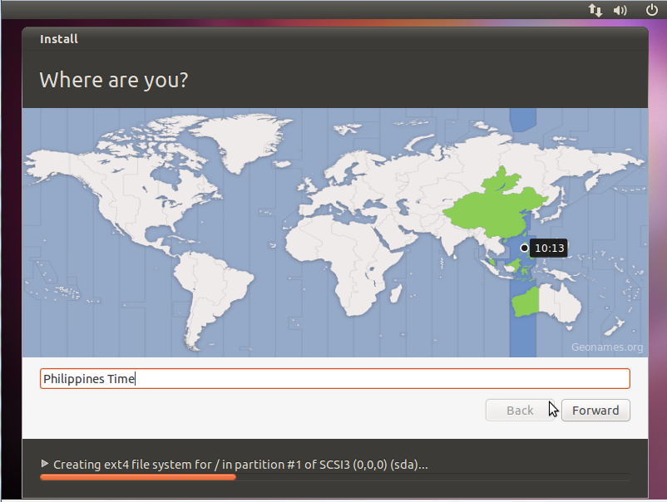
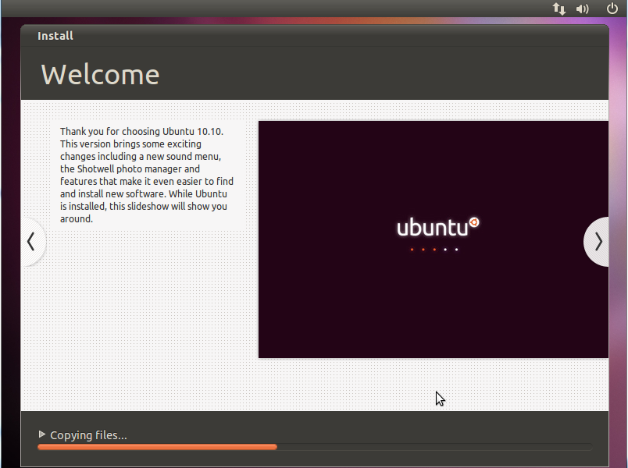
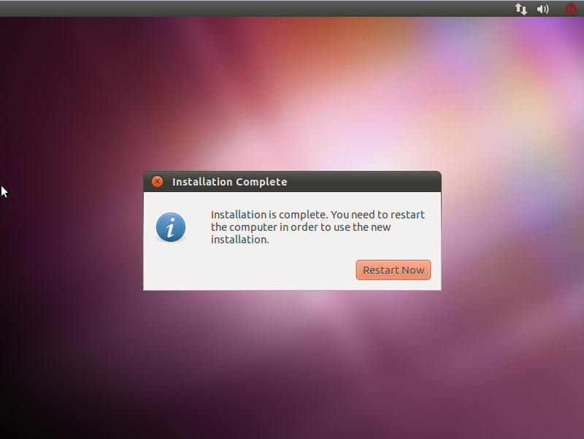
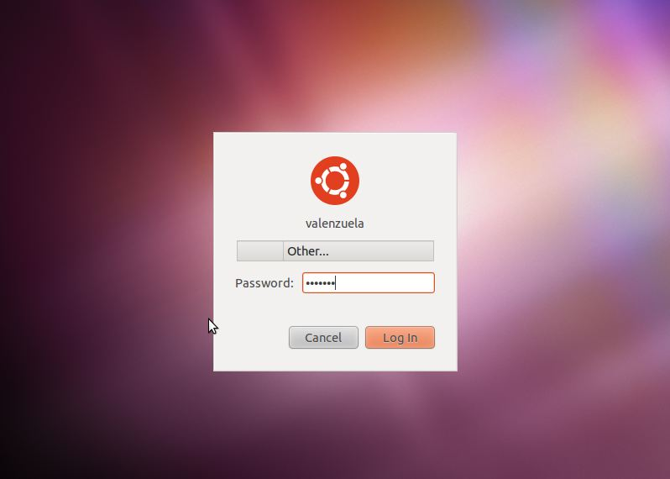
Installation

Slide 11
GRand Unified Bootloader / GRUB
Is a boot loader package developed to support multiple operating systems and allow the user to select among them during boot-up. GRUB was created by Erich Stefan Boleyn and has been further developed under the GNU project as GNU GRUB. The original package, sometimes known as GRUB Legacy, is still available for download but no longer being developed.

Slide 12
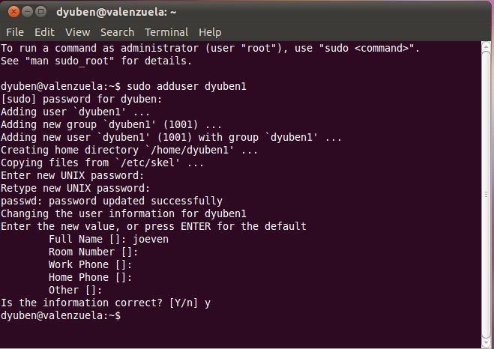
Adding User

Slide 13
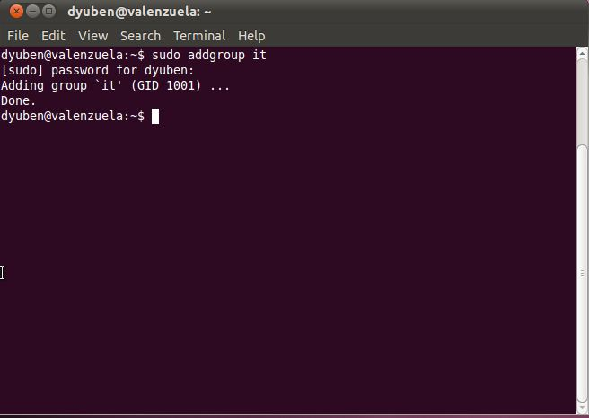
Adding Group

Slide 14
Policy Settings
Directory | User | Group | Other
IT | rwx | rwx | rwx
Human Resource | rwx | rw- | r--
Marketing | rwx | rw- | r--
Accounting | rwx | rw- | r--
Customer Service | rwx | rw- | r--
Pilots , F.A & Crews | rwx | rw- | r--

Slide 15
Common Linux Command
Command | Description
ls | Show all files and folders.
ls -al | Show all files and folders with its description.
pwd | Show the present working directory.
chmod | Changing the permission of a file or folder to its user, groups, and others.
touch | Creates a file.
mkdir | Makes a directory/folder.
rmdir | Removes a directory/folder.
groups | Shows your group.
rm | Removes a file.
cd | Go to $home directory
sudo addgroup | Adding group to a user.
sudo adduser | Adding user.
sudo apt-get install | Install new programs.
sudo reboot | Restart OS.
sudo halt | Shutdown OS.

Slide 16
Text Editor
Command | Description
vim/vi | Command line text editor.
Esc: w q! | Save and quit.
Esc:q! | Quit without saving.
less | To view the file.
a | To insert text.

Slide 17

Web Browser
Mozilla Firefox – Default Browser of Linux
A very popular open source Web browser for Windows, Mac and Linux from the Mozilla project. Including a search box for Google and other major sites, the Firefox user interface was designed to be easily customizable by adding "extensions," such as a stock tracker, autofill and hundreds of others.

Slide 18

X-Windows Desktop, Desktop Environment and Desktop Applications/Tools
The GNOME Project was started in 1997 by two then university students, Miguel de Icaza and Federico Mena. Their aim: to produce a free (as in freedom) desktop environment. Since then, GNOME has grown into a hugely successful enterprise. Used by millions of people across the world, it is the most popular desktop environment for GNU/Linux and UNIX-type operating systems. The desktop has been utilised in successful, large-scale enterprise and public deployments, and the project's developer technologies are utilised in a large number of popular mobile devices.

Slide 19

X-Windows Desktop, Desktop Environment and Desktop Applications/Tools
OpenOffice is the leading open-source office software suite for word processing, spreadsheets, presentations,graphics, databases and more. It is available in many languages and works on all common computers. It stores all your data in an international open standard format and can also read and write files from other common office software packages. It can be downloaded and used completely free of charge for any purpose.

